Slide 1
The Risks T
The Risks of Flooding to a Natural Gas Distribution System

Slide 2
Flood Planning
Risk Assessment
Design Element Practices and Considerations
Flood Emergency Preparation and Coordination
Post Flood Recovery Issues

Slide 3
Risk Assessments
Water Intrusion and infiltration into the system
Submergence of customers’ gas meters
Possible dislocation and exposure of sections of a distribution main due to road destruction and earth-shifting
Damage to above ground facilities
Regulator Station
Valve
Pipe hanging on Structures

Slide 4
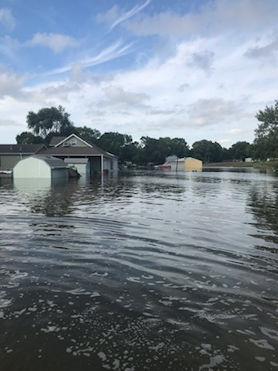
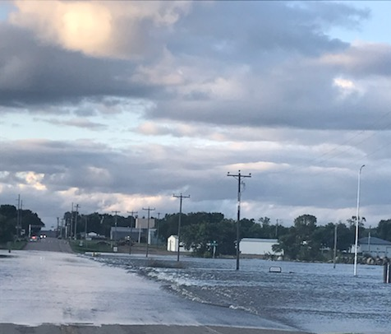
Risk Assessment – Infiltration
Generally a flood that does not cause a rupture of a gas distribution system will not damage buried gas lines.
Gas pressure will generally be great enough to prevent infiltration and should not be shut down.

Slide 5
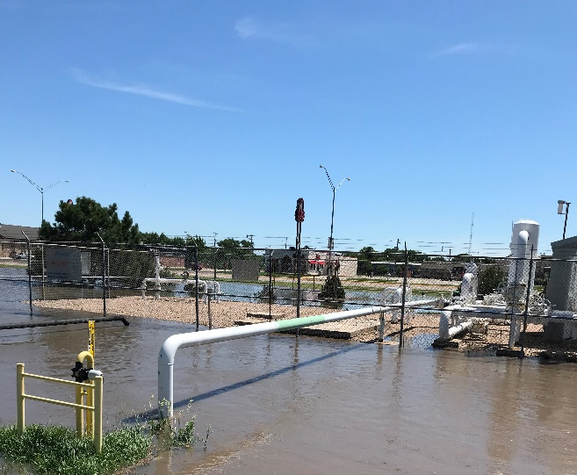
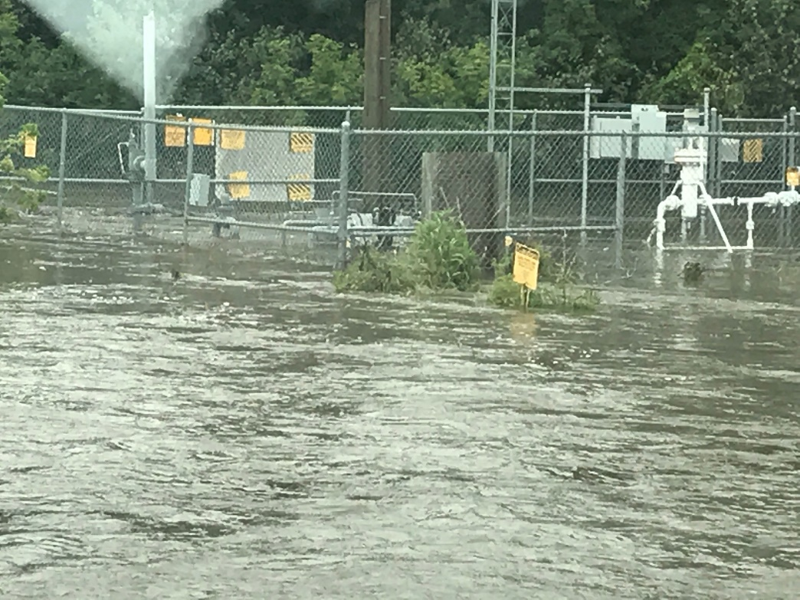
Risk Assessment – Above Ground Facilities
Submergence – Customers Meters and Regulating Station
Can it still function?

Slide 6
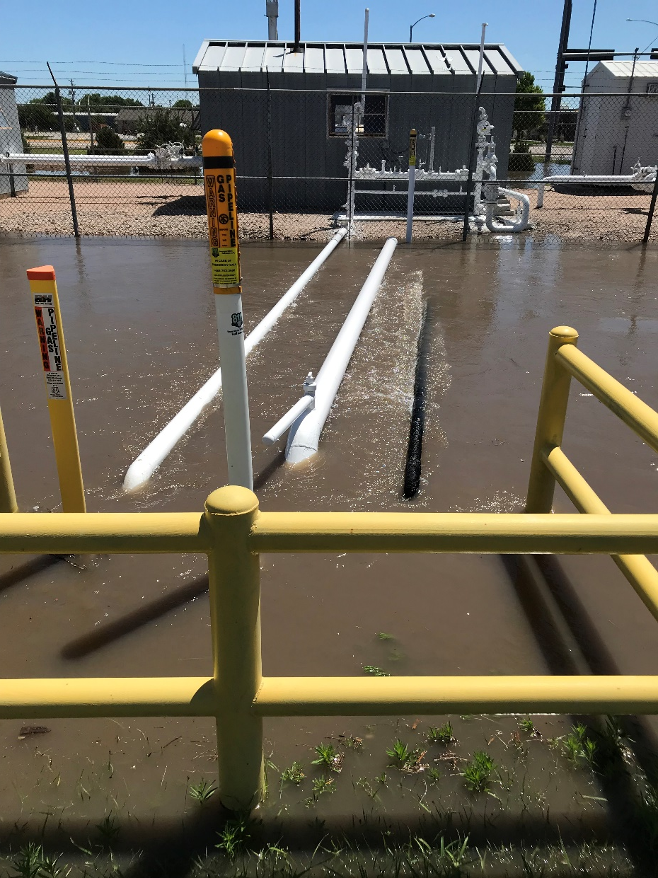
Risk Assessment – Above Ground Facilities
Damage
Regulator Station
Hairpin / Valve
Pipe hanging on Structures

Slide 7
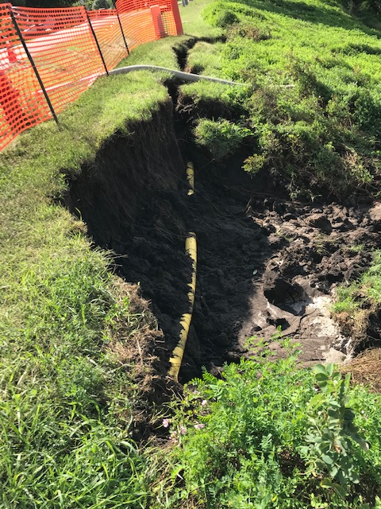
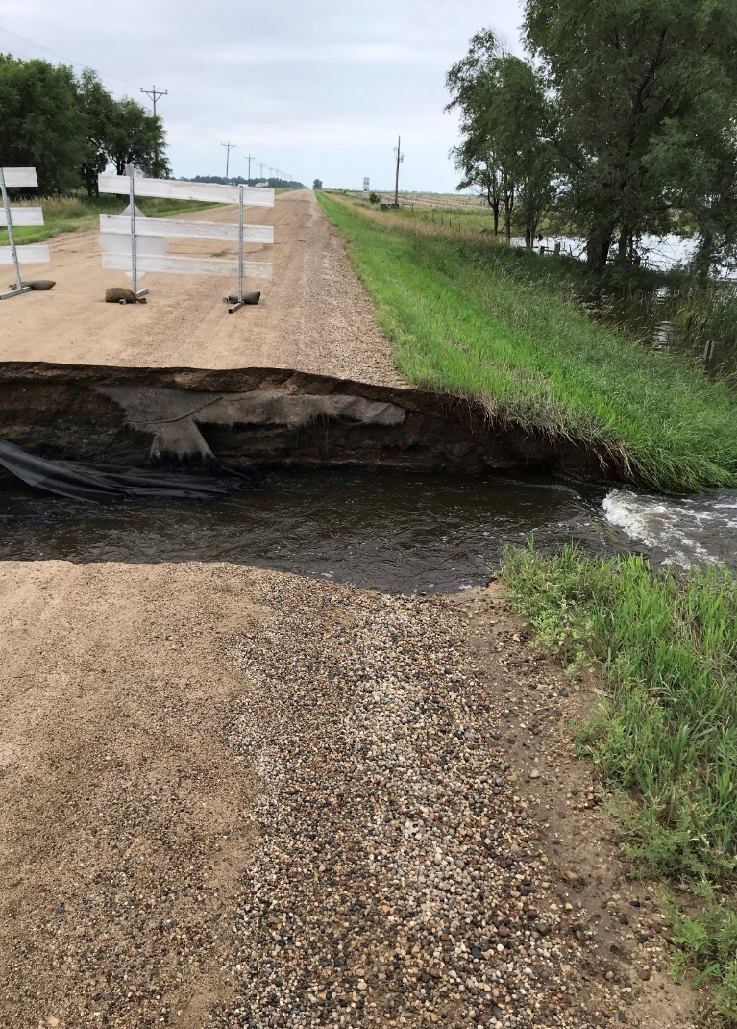
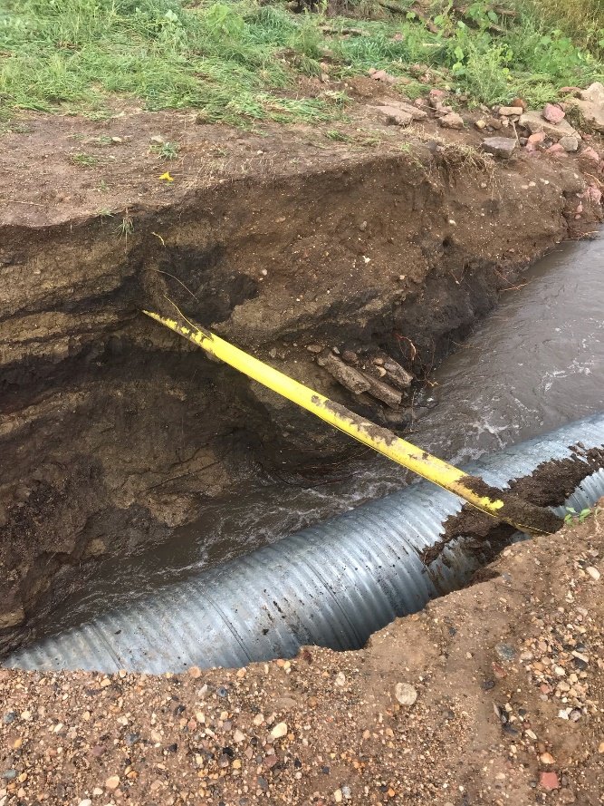
Risk Assessment – Pipe Exposures
Integrity of Pipe
Public Safety

Slide 8
Risk Management
Flash Flooding
River Flooding
Water Main Break

Slide 9
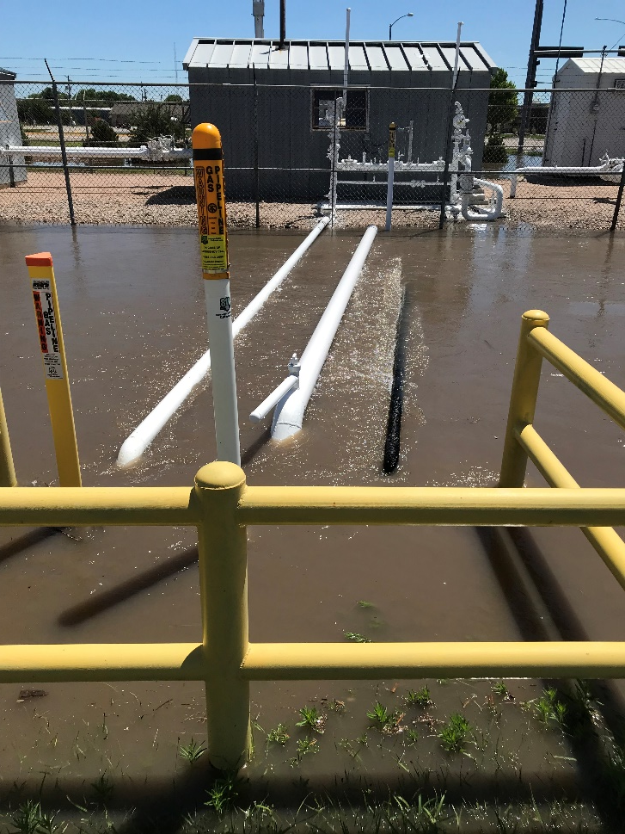
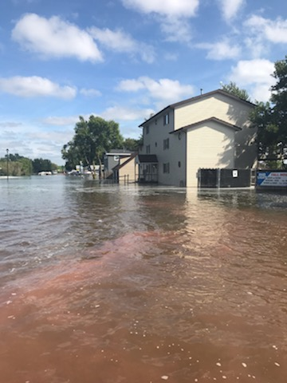
Flash Flooding
Wash Outs
Flooding of Facilities
Regulator Stations
Customer Meters
Notes:
Monitor these situations and, if possible have means of removing debris and develop a plan in case a failure occurs

Slide 10
Advisory Bulletin (ADB)
ADB-2016-03
Owners and Operators of Petroleum Gas and Natural Gas Facilities in Areas subject Heavy Snowfall or Abnormally Icy Weather
Advises owner and operators of the need to take appropriate steps to prevent damage to pipeline facilities from accumulate snow or ice.
Past event on natural gas distribution system facilities appear to have been related to either stress and ice or the malfunction of pressure control equipment due to ice blockage of pressure control equipment vents.

Slide 11
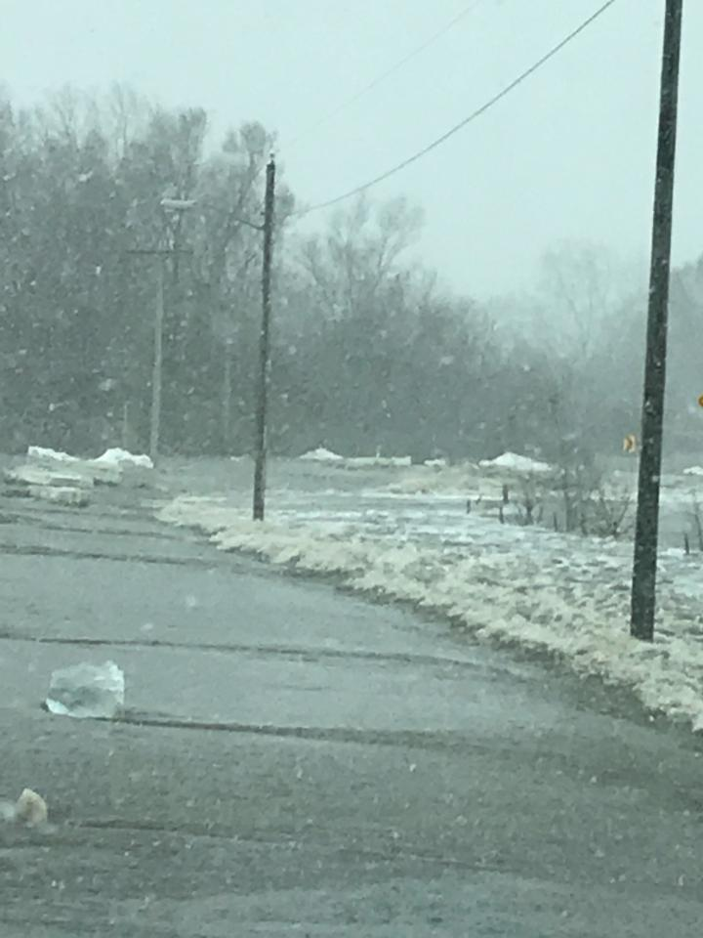
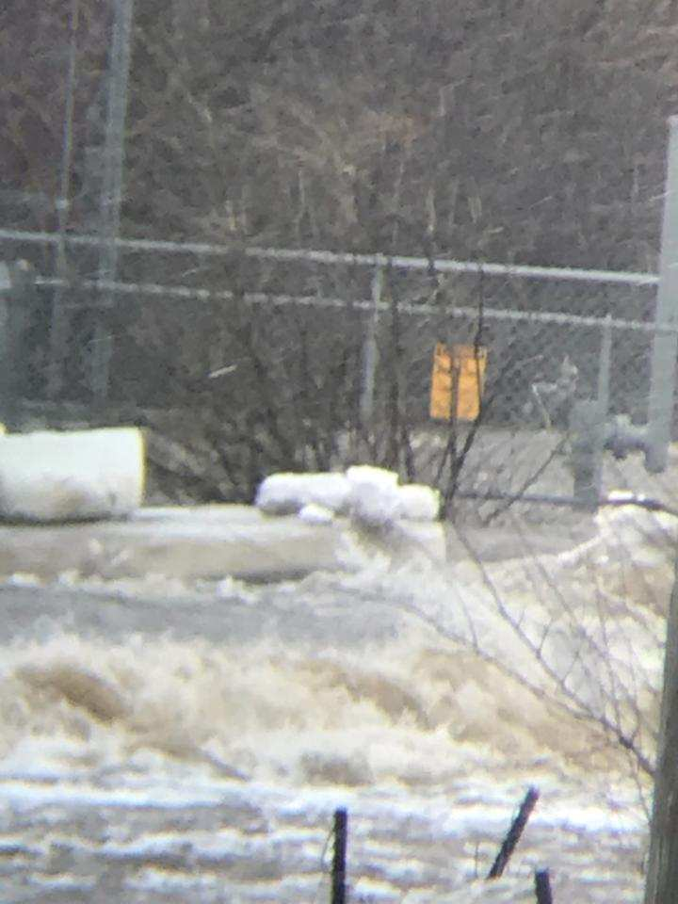
River Flooding – Winter Thaw
Threats can vary based on time of year

Slide 12
Advisory Bulletin (ADB)
ADB-2019-04
Water Crossings & Area Prone to Flooding
PHMSA issued an advisory bulletin to remind all owners and operators of gas and hazardous liquid pipelines of the potential for damage to pipeline facilities caused by severe flooding and actions that operators should consider taking to ensure the integrity of the pipelines in the event of flooding, river scour, and river channel migration.

Slide 13
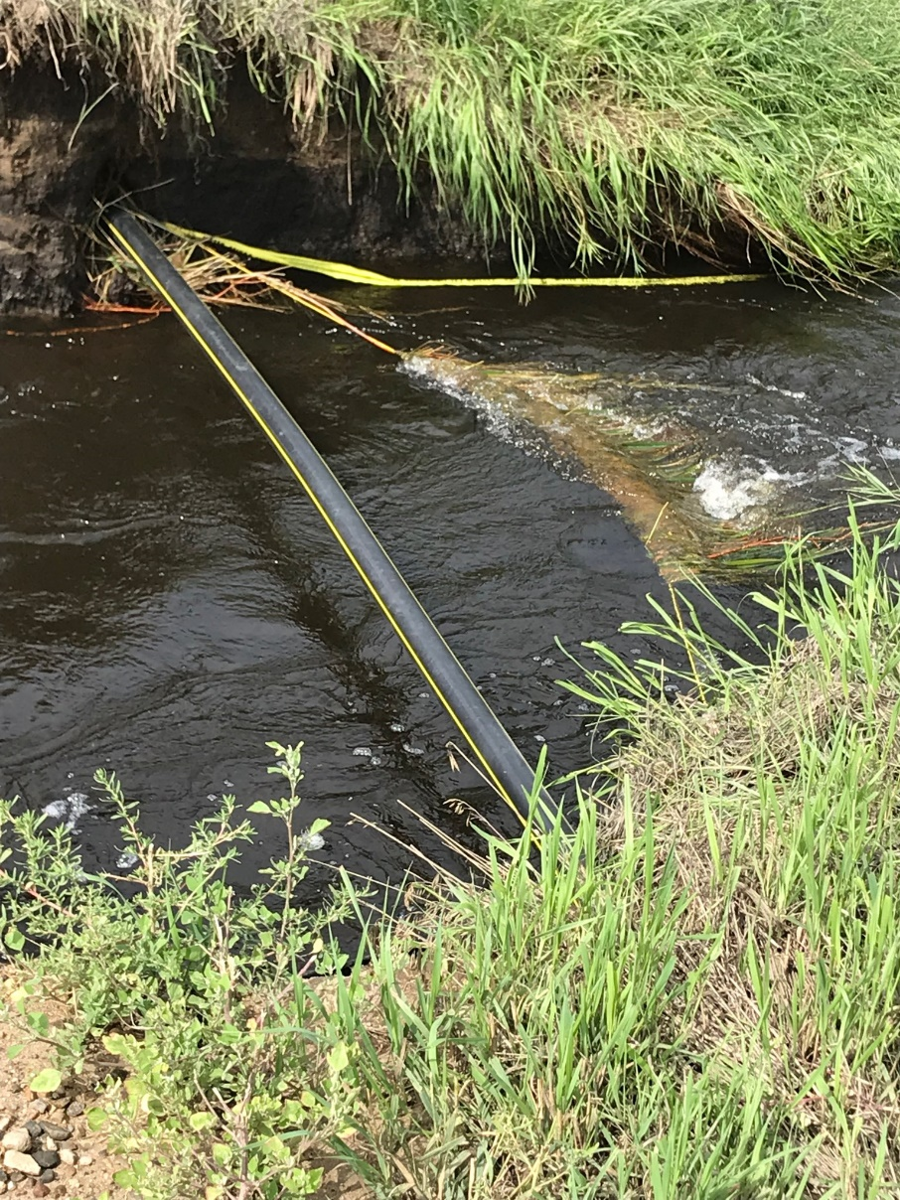
River Flooding

Slide 14
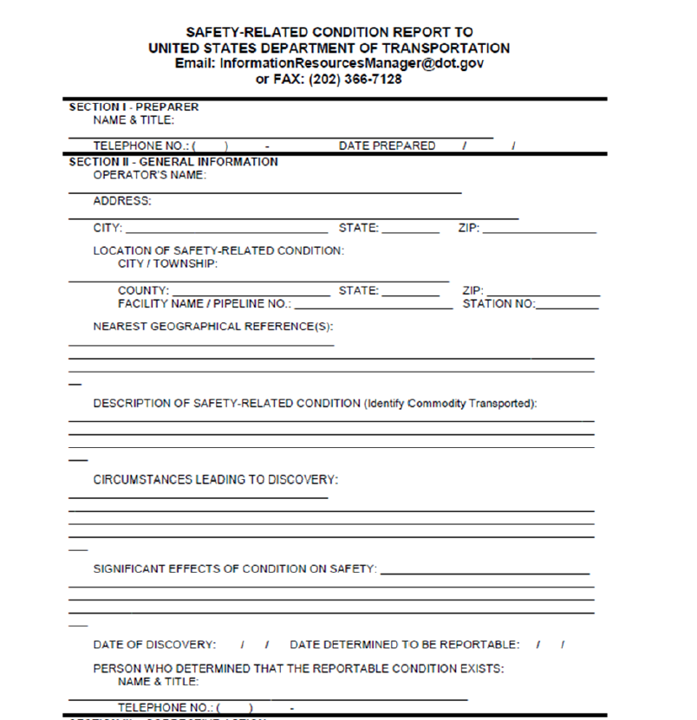
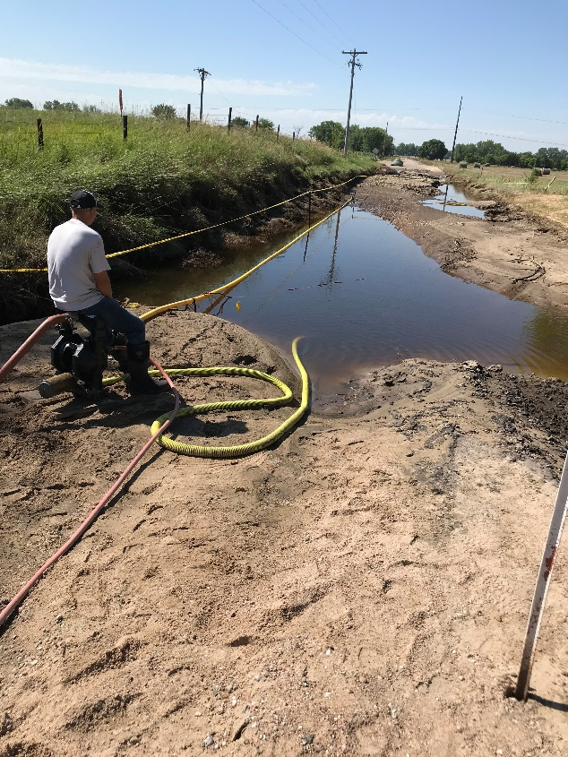
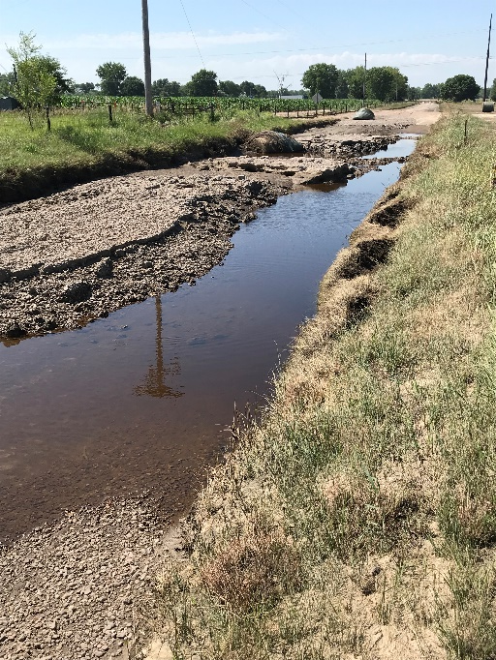
Safety-Related Condition (192.23)
Unintended Movement or Abnormal Loading by Environmental Causes which could affect the Serviceability or Structural Integrity of the Pipeline

Slide 15
Design Element Practices and Considerations
Pressure Regulating Facilities
Water Intrusion/Inflitration
Bridge Crossing
Critical Facilities Design and Review

Slide 16
Flood Emergency Preparation and Coordination
Incident Command System
Resource Allotment
Response Plan
Flood Emergency Preparation and Coordination Checklist

Slide 17
Post Flood Recovery Issues
Tracking Impacted Customers
Meters and Regulators
Guidance to Customers
Post-Recovery

Slide 18
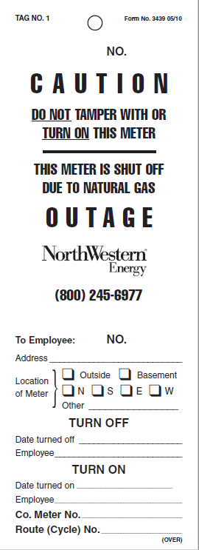
Tracing Impacted Customers
How to track?
Utilize No Gas Procedures
Turn on process is much more staggered than a traditional no gas so interaction with your CIS is critical in tracking customers

Slide 19
Customer Meters and Regulation
Replace or Reuse
Full Submergence
Replace --

Slide 20
Guidance to Customers
Gas Service to a customer’s premise not turned back on unless all submerged appliances, regulators and control devices have been inspected by a qualified person and replaced or repaired as necessary.
As a utility our company has chosen to not accept the role qualified person to inspect appliance

Slide 21
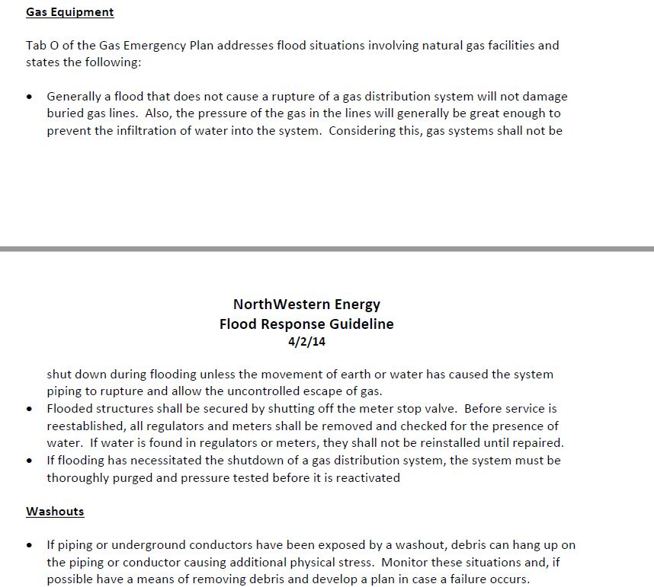
Conclusion
Response Plan
Share Knowledge among Operating areas

